Slide 1
Group F4: Semmtech
Final Presentation
Xiaotian Chen, Florian de Graaf, Zsófia Katona, Dimitrios Papadopoulos
January 26 2024

Slide 2
Recap
Goal: Transform EU Taxonomy into Linked Data Ontology
Start with data in csv/xls
Manual and automatic pipeline to construct ontology
Extract information using NLP to enrich taxonomy
Focus on Construction Sector but everything is modular and expandable

Slide 3
Teaser!

Slide 4
Visualization of our previously proposed pipeline
Ontology (Turtle)
Platform (unknown)
Input file (Excel)
Convert file to .ttl
Manually convert data into ontology
Export ontology
Upload & browse ontology to platform
Manual
Inspect data, understand the structure
Export free text
Add extracted concepts to nodes
Text converter (Python)
Automatic
Convert free text to key concepts with NLP
EDA
Processing / ontology creation
Evaluation
Notes:
3 steps: EDA, Processing, Evaluation
Fully automatic might lead to errors: manual + automatic part = semi-automatic construction

Slide 5
Visualization of our updated pipeline
Export free text
Input file (Excel)
Schema (Turtle)
Platform (Laces or Protege)
Export ontology
Manual
Inspect data, understand the structure
Manually create Ontology Schema
Browse ontology in the platform
Resources and limitations extraction (ChatGPT API)
Automatic
Automatic part in python notebook
Ontology (Turtle)
Final Ontology (Turtle)
Convert free text to key concepts with NLP
Convert data into instances of the ontology
Add extracted concepts to the original nodes
EDA
Processing / ontology creation
Evaluation
Notes:
3 steps: EDA, Processing, Evaluation
Fully automatic might lead to errors: manual + automatic part = semi-automatic construction

Slide 6
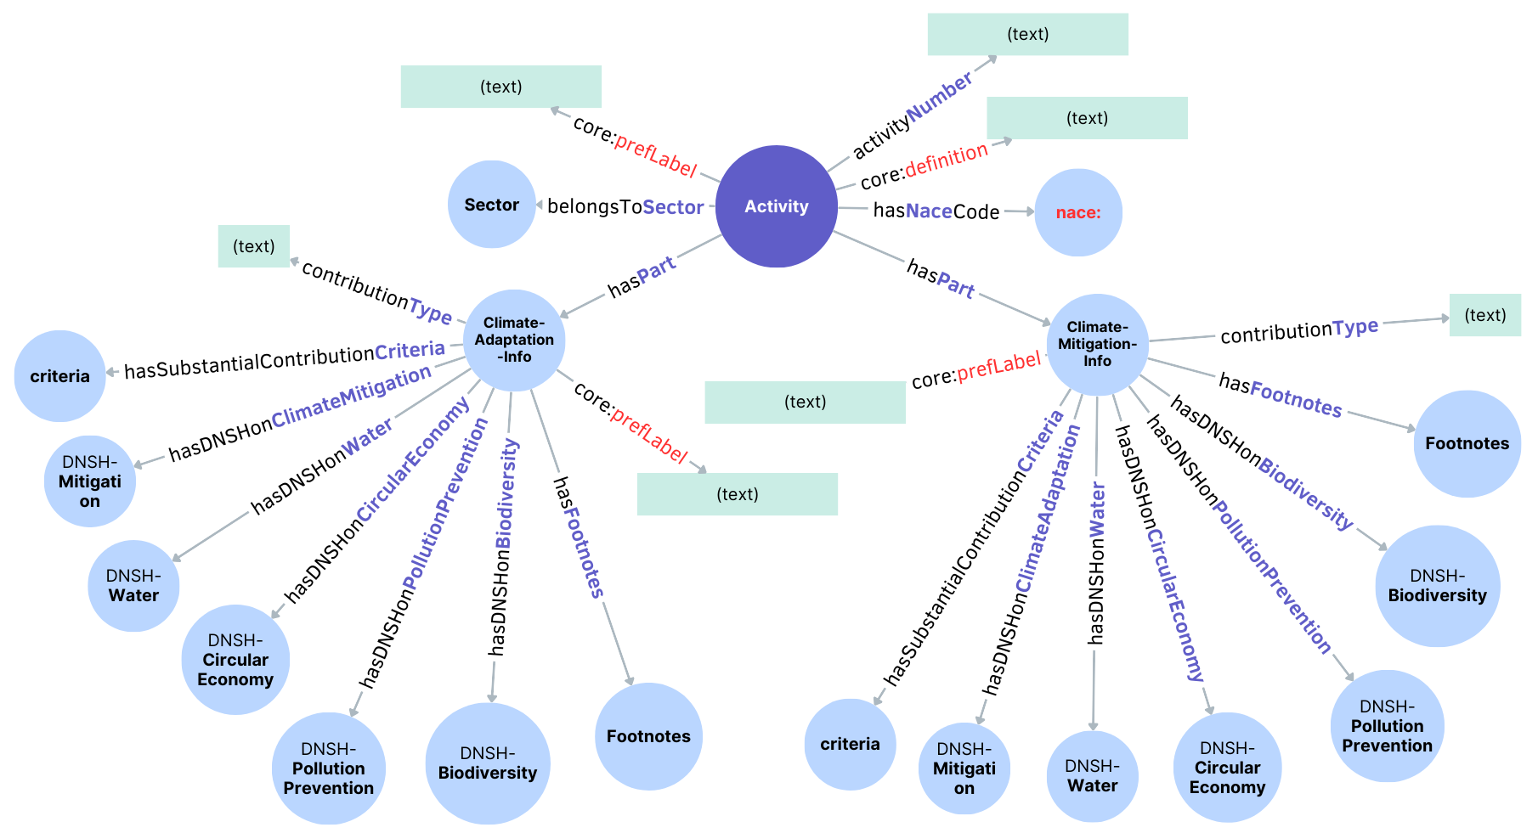
Ontology Schema

Slide 7
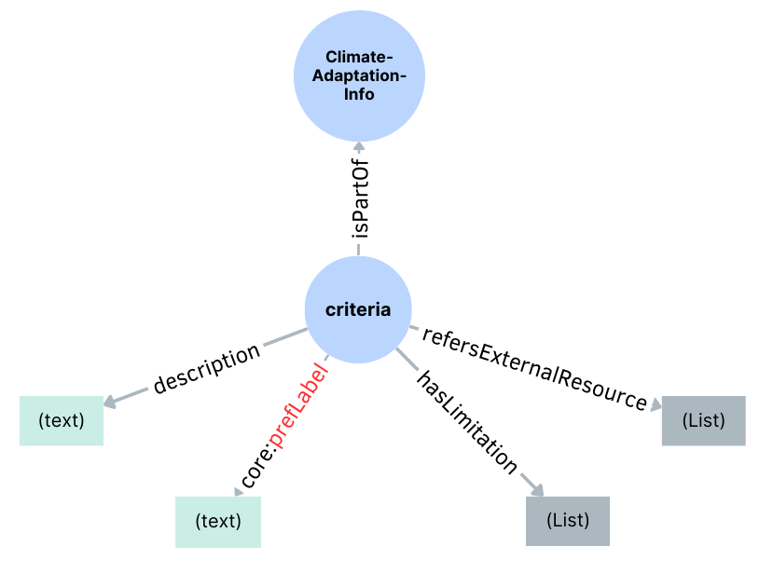
Ontology Schema

Slide 8
ChatGPT API
We use chatGPT 4 pre-trained model and specific prompts to extract information from free text
External resources mentioned. E.g.:
“Appendix A”, “https://www.ipcc.ch/reports/”, “Directive 2010/31/EU”
Limitations found. E.g.:
"urinals use a maximum of 2 litres/bowl/hour"
"wash hand basin taps and kitchen taps have a maximum water flow of 6 litres/min"
“For buildings built before 31 December 2020, the building has at least an Energy Performance Certificate (EPC) class C”
Notes:
FULL AUTOMATION:
We initially aimed to achieve automatic extraction of key information by utilizing the DeBERTa model. However, the results obtained after processing the sample texts were far from satisfactory. Therefore, we discovered that achieving complete automation in both extracting and processing information is incredibly challenging.
MORE MANUAL METHODS:
We looked into methodologies for ontology construction that rely on human knowledge engineering. While many of these are mostly guidelines with a lot of freedom for the specific problem, the general steps and approach is documented clearly in some (mainly METHONTOLOGY in our search). Therefore, we believe we could use such a framework as a basis for building our ontology and enhance it through insight we gain from NLP on the parts of the taxonomy which are given in free text.

Slide 9
Validating our approach
Free text extraction: what was the performance of the extraction and how much does it help to make the taxonomy easier to comprehend?
Pipeline quality: is our pipeline easy to understand and reproduce?
Ontology user experience: does our ontology help users complete taxonomy-related tasks more efficiently?
User input!
Notes:
We validate our approach through three aspects:
The quality of the information extraction from free text: how accurate was it and how much does it contribute to easier comprehension of the taxonomy?
The quality of the complete ontology construction pipeline: is it easy to understand and reproduce?
The ontology’s contribution to user experience: is it indeed a useful in completing taxonomy-related tasks?
The latter two aspects require user input to assess.

Slide 10
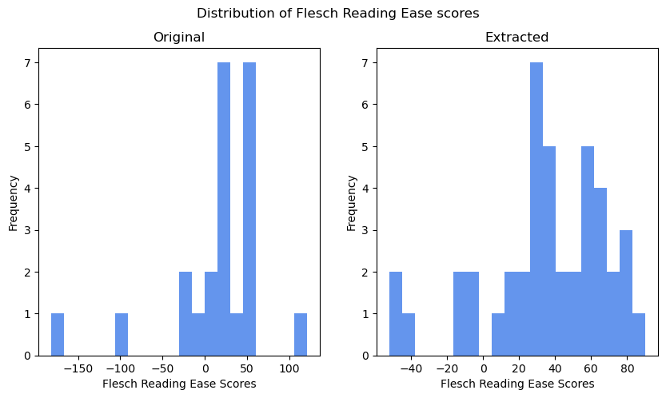
Evaluation of free text extraction
Recall
Precision
+
easier to read
Notes:
In order to evaluate the quality of the free text extraction, we look at two common metrics, recall and precision. I.e., could we find all relevant information which we wanted to extract from the text, and is there possibly irrelevant information that was mistakenly extracted?
Furthermore, we look at the reading ease scores of the pieces of free text contained in the taxonomy in the original tabular format versus our Linked Data format. As can be seen, reading ease scores appear to be higher in our ontology, which means that they are easier to comprehend.

Slide 11
Pipeline quality
Participants use our pipeline (Jupyter Notebook) to convert the Taxonomy into Linked Data format
Follow-up questionnaire assesses their experience
Smoothness of pipeline, any problems/bugs
Ease of understanding, user confidence
Time requirement
Notes:
The quality of the pipeline is assessed by asking a group of users to apply our pipeline (in the form of a Jupyter Notebook) to the taxonomy and complete a questionnaire about their experience. In this, we ask them about the:
Smoothness of the experience, and if they ran into any problems
How easy they felt it to apply the pipeline and how confident they were that they understood what it did (which aims to tell us about the reusability of our code)
How long it took them to complete the timeline, with which we want to see if it could be efficiently employed in the future

Slide 12
Ontology user experience
Participants answer compliance-related questions using either the original EU Taxonomy or our Linked Data representation. Correctness of answers as well as time is assessed.
EXAMPLE
Are there requirements which only need to be fulfilled during the construction of new buildings if they are above 5000 m² in order for the activity to be considered as substantially contributing to the goal of climate mitigation? If yes, what are these requirements?
Notes:
The user experience is assessed in a task-oriented way, by asking a group of users to answer questions which are related to the taxonomy-compliance of different economic activities (i.e, as if they were reporting on the activity to see if it was aligned with the taxonomy). One group needs to do this using the original taxonomy, browsing it either in an Excel file or on the webpage Navigator, and the other group uses Protege to navigate our ontology. We measure the correctness of the answers as well as the time it takes to complete them.
Here is an example question they could face in this survey. As you can see, questions related to the sustainability of activities are very complex, and we hope to simplify this process with the Linked Data representation.
We must note that an important limitation of this study is that we do not have our own user interface developed for ontology browsing, so we have to rely on third-party apps. We believe that the front-end is very important for this task, so it would be best to measure this once a UI has been developed specifically for this purpose.

Slide 13
Future work
Data Extension:
In the future, data from various sectors will increasingly be utilized to generate Linked Data, enabling the construction of a comprehensive architecture.
Data Synchronization:
After the data extension, the ontology can be used as a new platform which can synchronize the data update on the EU Taxonomy official website.
Hyperparameter Fine Tuning:
Incorporate hyperparameter fine-tuning techniques to optimize the model's performance and adaptability across diverse datasets and tasks.
Large Language Model (LLM)：
This model can be trained as a Large Language Model (LLM) as an ultimate goal by exposing to extremely large-scale datasets and utilizing user feedback for optimization.
Notes:
This model can be trained as a LLM after the exposure to extremely large-scale of datasets. Users’ feedbacks could be used for optimization of the model.

Slide 14
Live Demo!

Slide 15
Questions?

